Slide 1
DL Researcher assignment
Tasos Tsourtis

Slide 2
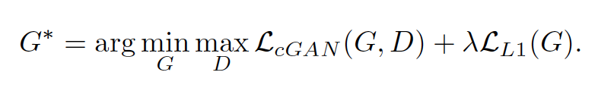
Assignment 1: model
Used model pix2pix¹ which is a conditional GAN that learns a mapping from input images to output images.
Generator architecture is a U-net: downsampling/upsampling (encoder-decoder) with skip connections.
Loss function: vanilla conditional GAN with weighted L1 regularization (MAE between generated ↔ target) along with Binary Cross-entropy
Discriminator: patchGAN that classifies each image patch as real/fake.
Discriminator loss: Binary Cross-Entropy
Structured loss
penalizing generated image structure
Image-to-Image Translation with Conditional Adversarial Networks, Isola et al.
Notes:
pix2pix : >17K citations
Knew them from Cycle GAN
Not more robust/computationally intensive WGANs, no gradient penalty. L1 helps with blurry images instead of L2 regularization.
Tensorflow implementation
HAD some issues with CONVERTING PIL jpeg images to tensors.

Slide 3
Assignment 1
Split 80% - 20% for training, restricted to 800 instead of 1425 images due to RAM overflow issues.
1 corrupt image (id 465) discarded
Color Images with 1 instead of 3 channels discarded from train set
Modified model capacity by adding 2 layers in the Generator to account for 512x512 resolution (originally suited to 256x256): 57M → 66M parameters
Pix2pix hyper-parameters are kept
Model requires 14.2GB of GPU RAM (trained on T4 in Collab) and ~2h for 40K steps.
Did not fine-tune as the free-tier restricts CPU-time.
Notes:
Corrupt image affected the whole data loading pipeline. Some issues with PIL plugin in Hugging Face dataset
Model marginally fits to T4, restarted runs more than 30 times! Extremely slow locally…

Slide 4
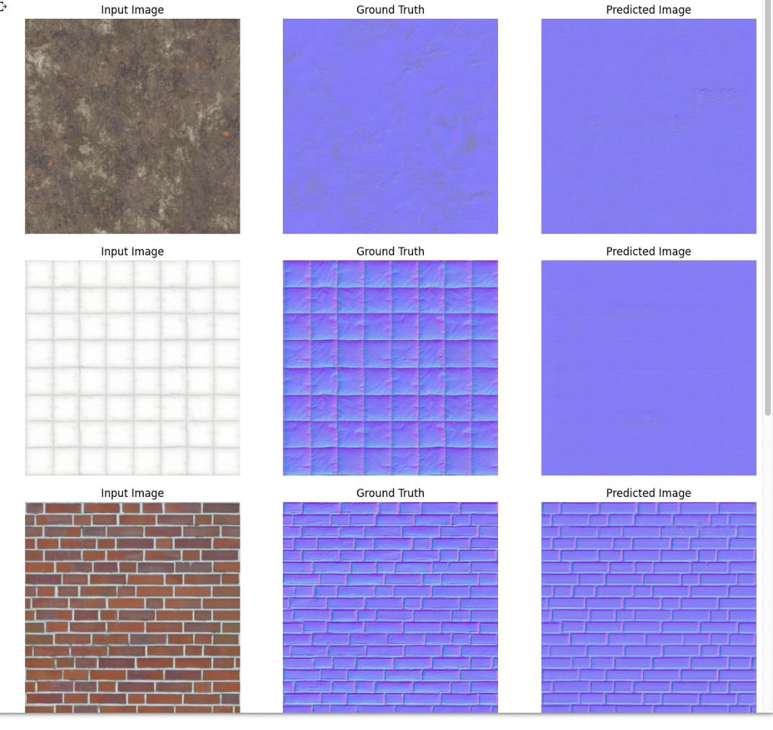
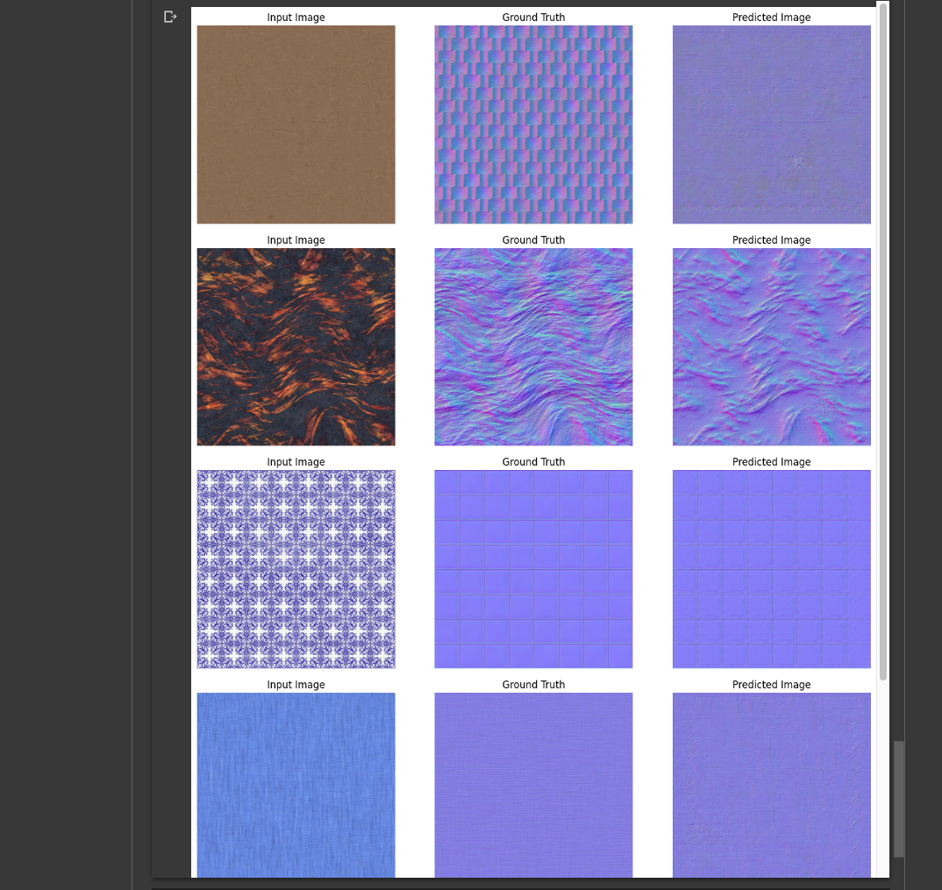
Assignment 1: Results (40000 steps)
Notes:
Generally converges after 40K epochs even for half of the train set.

Slide 5
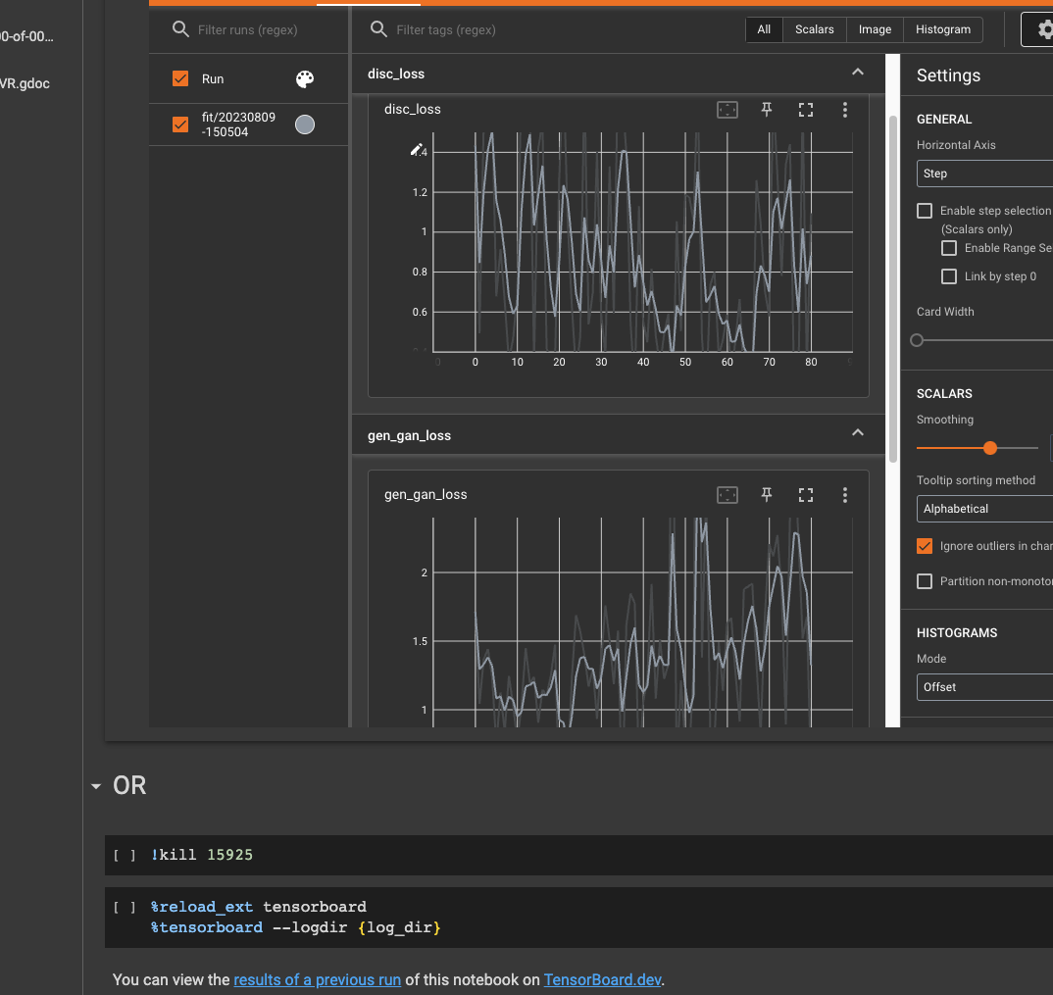
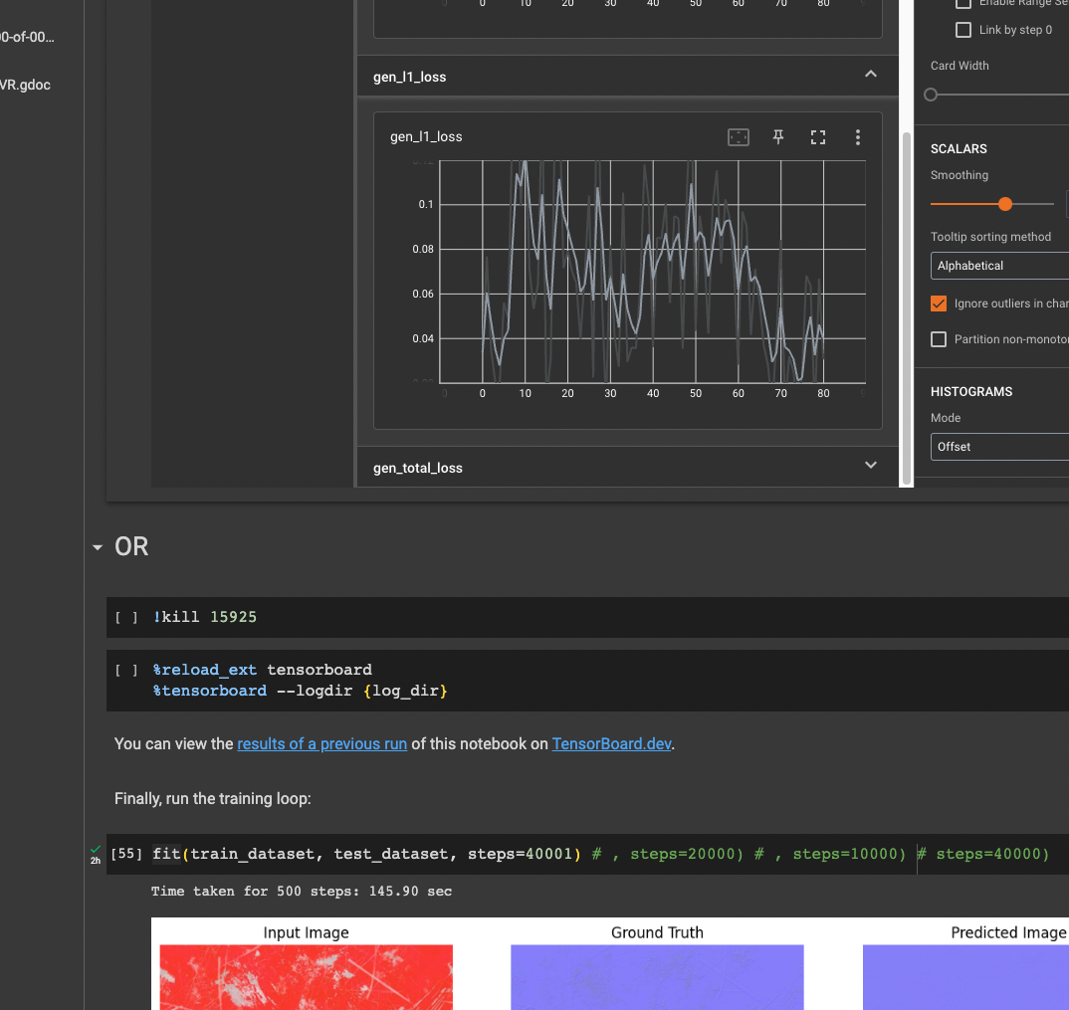
Assignment 1: Results
L1 loss decreases reaching a plateau (not shown).
log(2)=0.69 is a reference point for Binary Cross-Entropy
Discriminator loss: below 0.69 → better than random
Notes:
Issue with the last logs (not shown here!)

Slide 6
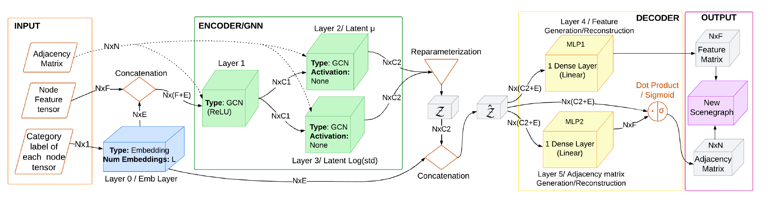
UniSG-GA

Slide 7
Days 1-2: assignment 1
Days 1-2: familiarity with ECS and classification example
Days 2: heterogeneous graphs
Days 2: setting up a working end-to-end conditional GVAE on time (trs of an object dependent on this variable) → issues due to less experience with torch
Days spent in: setting up M1 (ATLAS model hardcoded in cuda), ubuntu machine with CUDA (failed after 2 days), windows machine with CUDA (pyg_lib wheels not available), Collab instances maxing out RAM/ timing-out/ failing, rendering/storing modified scenes, fixing repo dependencies, files/functions from other branches, bugs, missing imports/packages etc

Slide 8
Assignment 2
Initial plan:
generate/visualize a sequence of scenes with one modified entity component: i.e. translation of the Chair in default room scene
Associate entity translation with time component t. i.e. char moves (translates) in x-axis as t increases
Convert list of scenes in a list of graphs to compose the training set
Train conditional GVAE on t, so that it learns the association t ↔ entity translation
Use the decoder part to generate new scenes given t (Possibly augment scenes out of the range of t in the training data)
Add proper losses (as regularization terms) that impose the association in 4.

Slide 9
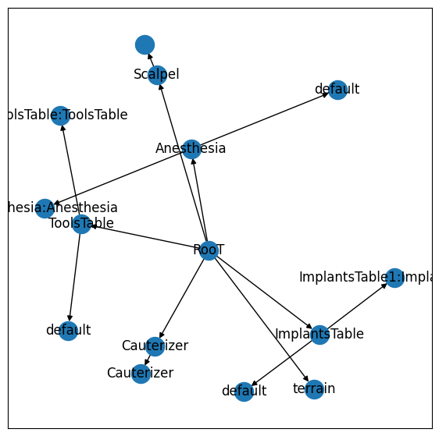
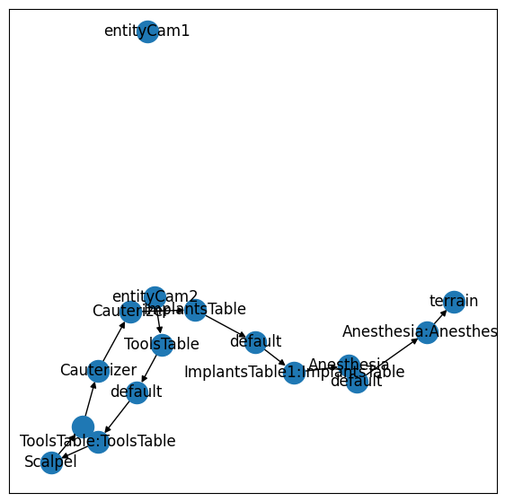
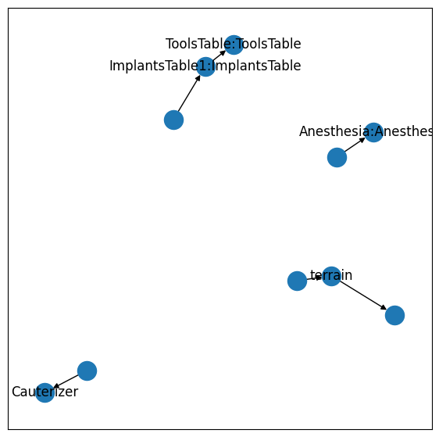
Assignment 2
Propositions on Heterogeneous Graph (Room Classification example)
entities
trs
mesh

Slide 10
Assignment 2
Propositions on Heterogeneous Graph (Room Classification example)
General comment: Overfitting is probable. Random “jittering” of the objects (ECStoGNN()) while generating the training graphs does not suffice. In mathematical terms, the training distribution of graphs has a small variance. E.g. a classifier being trained on transformations of images of one cat and one dog (crop, resize, pad etc) instead of images of various cats and dogs. Enrich training distribution by adding/removing scene-specific entities.
In addition, the graphs corresponding to CreateORScene() and CreateRoomScene() have very different node degrees due to different number of entities.
This is implied by reaching 100% accuracy in a few epochs in Section 5.1 for a high capacity network for the given dataset: 5 HeteroConv layers of GraphSAGE and a high, constant learning rate.
Notes:
TYPOS/ COMMENTS in SECTION 5 of the pre-print.

Slide 11
Assignment 2
Propositions on Heterogeneous Graph (Room Classification example)
SageConv paper mentions k=2 (hops) neighbours in Message Passing. Current network is shallow → one layer GCNConv should suffice (avoid over-smoothing). Here 5 Sage convolutions are employed.
Try different ‘aggr’ in HeteroConv instead of: HeteroConv(..., aggr=’mean’) → it helps with over-smoothing of stacked GNNs and is suitable for low cardinality graphs, so that the graph is more “expressive”.
When nodes increase → add skip-connections between GNNs (“JK-net”) Leverages different neighborhood ranges to enable better structure-aware representation, for each node. Outperform GCN, GraphSAGE and GAT in prediction tasks. “Representation Learning on Graphs with Jumping Knowledge Networks” https://arxiv.org/abs/1806.03536
Use weighted scheme in forward pass instead of: final = x1 + x2 + x3 In order to emphasize mesh graph over the other two. e.g. a latent representation of scalpel should be more important in a OR scene…

Slide 12
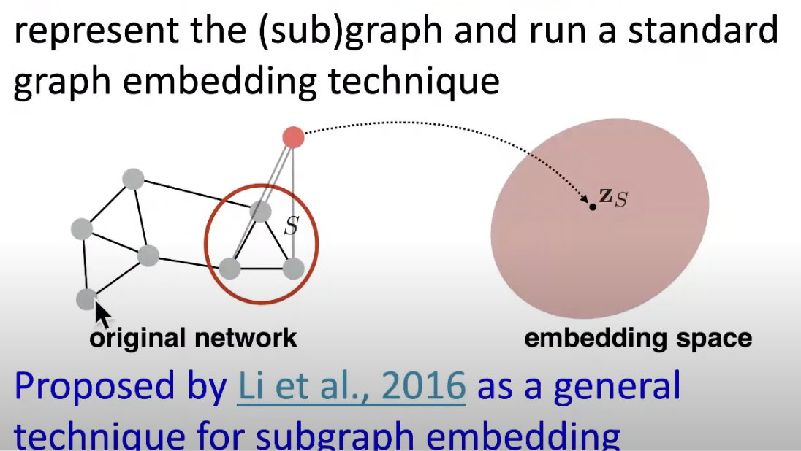
Assignment 2
2. Propositions on cGVAE
In the light of β-VAE¹ use an adjustable parameter (loss constant) for balancing latent channel capacity with Reconstruction loss (KL term). → better disentanglement of latent representations.
Use an additional loss component penalizing for translations: [node-level] Extra node feature (translation vec.) in ‘trs’ graph → enforces relative position of components to avoid overlapping or floating
[graph-level] use different subgraphs as scalpel attached to hand Subgraph Neural Networks, NIPS 2020
beta-VAE: Learning Basic Visual Concepts with a Constrained Variational Framework, Higgins et al.

Slide 13
Assignment 2
2. Propositions on cGVAE
GVAE on molecules with: node-loss, edge-loss, node+edge-loss → approximate reconstruction loss on top of regularization (KL) ALSO, different mu/sigma per node (upon encoding).
https://github.com/deepfindr/gvae
https://arxiv.org/abs/1611.07308

Slide 14
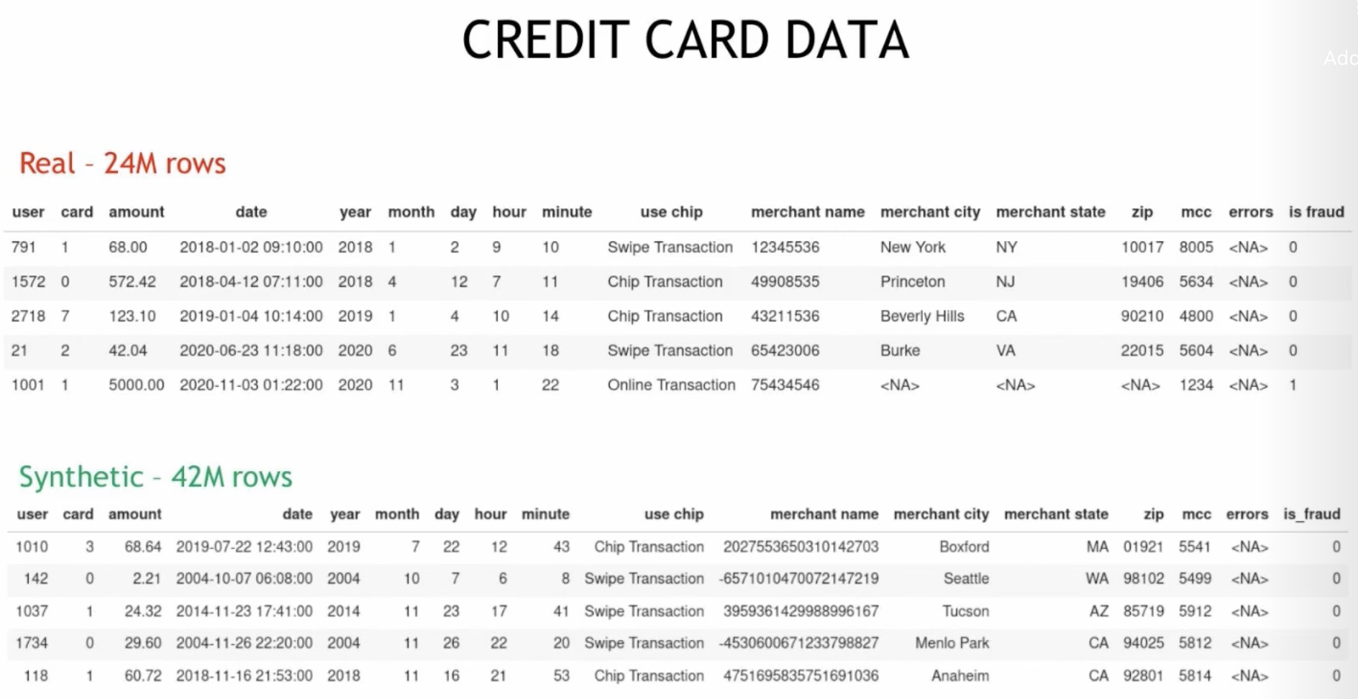
Using GPT based approach
Convert graph data in a (wide) structured, possibly sparse array. Rows are scenes, columns are features: entity type, coords, orientation (not mesh)
Synthetic Tabular Data generation using Transformers, Em. Skoullos, NVIDIA

Slide 15
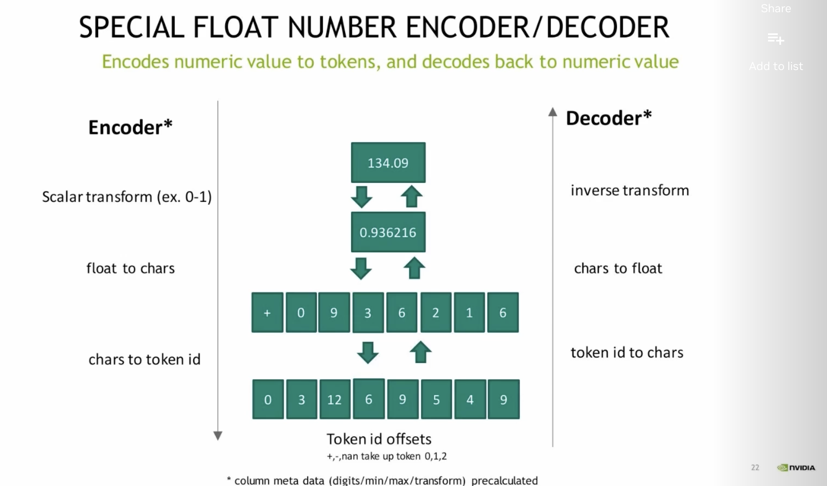
Using GPT based approach
The generated array can represent a graph (16:00). Numerical features are encoded as tokens and correlations among features are captured.
Eg. Train on a variety of scenes and learn the relative position (trs) of entities
Generate new scenes that respect the distribution of entities and their components
Sample scenes given a query of specific entities
Synthetic Tabular Data generation using Transformers, Em. Skoullos, NVIDIA

Slide 16
Assignment 2
Initial plan:
generate/visualize a sequence of scenes with one modified entity component: i.e. translation of the Chair in default room scene
Written CreateScenes.py: view_scene() Works on Windows (python kernel fails on OSX/Ubuntu).
Notes:
CUDA issues

Slide 17
Assignment 2
Initial plan:
generate/visualize a sequence of scenes with one modified entity component: i.e. translation of the Chair in default room scene
Associate entity translation with time component t. i.e. char moves (translates) in x-axis as t increases
for i, comp in enumerate(scene.world.components):
if isinstance(comp, BasicTransform):
if comp.parent.name == 'Chair':
scene.world.components[i].translation[1] = new_z # Z-axis
scene.world.components[i].trs[1][-1] = new_z

Slide 18
Assignment 2
Initial plan:
generate/visualize a sequence of scenes with one modified entity component: i.e. translation of the Chair in default room scene
Associate entity translation with time component t. i.e. char moves (translates) in x-axis as t increases
Convert list of scenes in a list of graphs to compose the training set Attempted to create a list of scenes with chair z-axis translated by dz → failed to append the modified scenes → saved the graphs by calling Converter.ECStoGNN(tranlsated_scene) and worked with those training data

Slide 19
Assignment 2
Initial plan:
generate/visualize a sequence of scenes with one modified entity component: i.e. translation of the Chair in default room scene
Associate entity translation with time component t. i.e. char moves (translates) in x-axis as t increases
Convert list of scenes in a list of graphs to compose the training set
Train conditional GVAE on t, so that it learns the association t ↔ entity translation
I have not resolved all the technical issues due to lack of time. I embedded data.t using the torch.nn.embedding() layer, then concatenated with node embeddings.

Slide 20
Conclusions
I have a clear understanding of the methodology and models used in the pre-print
Lost too much time on setting up three machines/technical issues/branch WIP
I have thoughts/ideas on possible directions of this research task
A working end-to-end cGVAE implementation would have been feasible if I had a better understanding of Elements as I do now.

